Slide 1
Investment appraisal techniques: valuing a future income stream
Recap of process for making balanced investment decisions
Appraisal techniques
Static methods - payback
Time value of money concept
Discounted cash flow methods:
Net present value (NPV)
NPV using annuities
Internal rate of return (IRR)
Information needs to value a target company (earnings method)

Slide 2
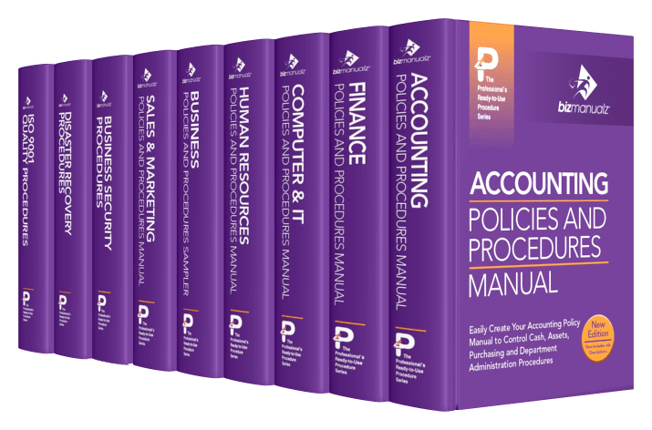


Balanced investment decisions
Do capital budgeting manuals help or hinder?
Spreadsheet models & analytical techniques
Can stifle creativity
Managerial intuition (gut feel) & behaviour
On its own is risky

Slide 3
The Payback Rule
The Payback Rule
The amount of time required for an investment to generate cash flows sufficient to recover its initial cost

Slide 4
The Payback Rule
Accept
Payback period is less than benchmark
Reject
Payback period is greater than benchmark

Slide 5
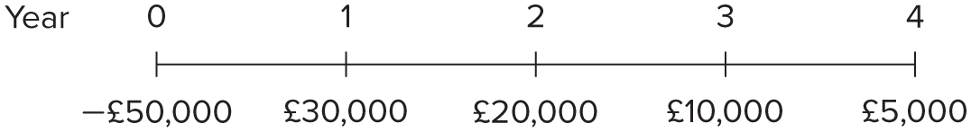
253
The Payback Rule
What is the Payback Period?

Slide 6
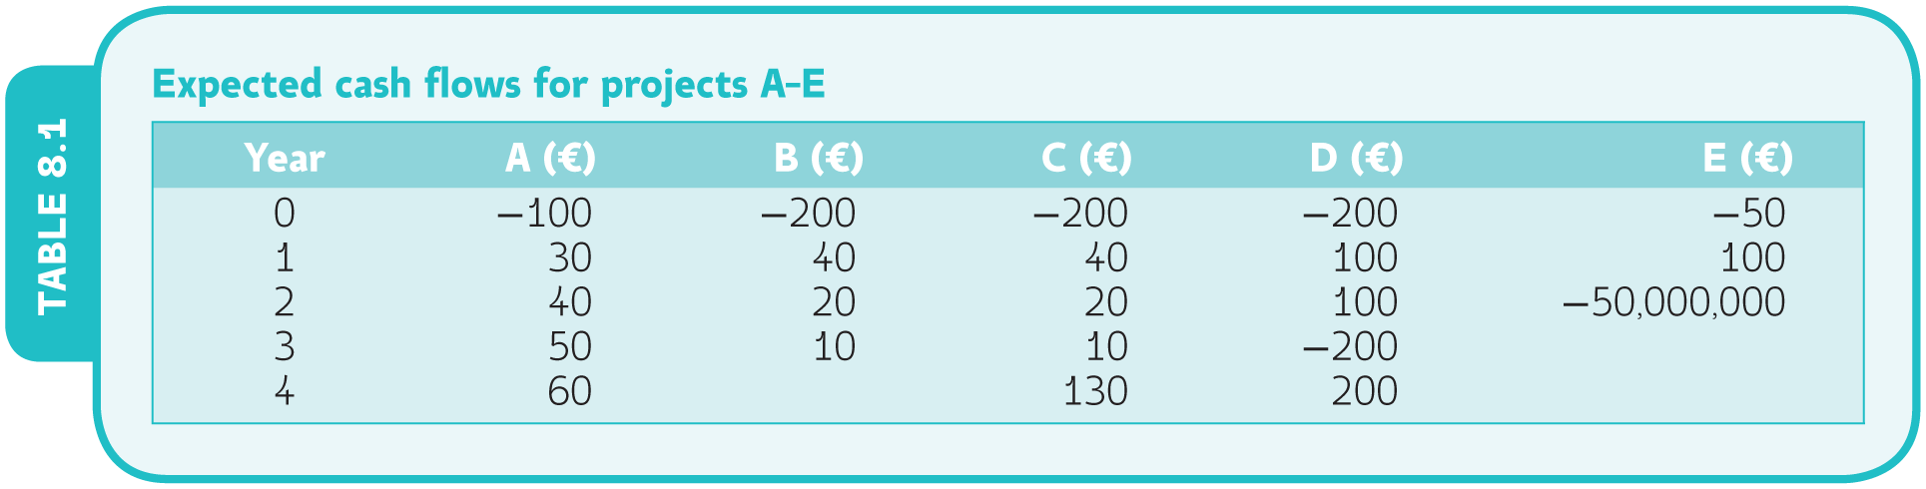
The Payback Rule
Analysis of the Payback Period Rule

Slide 7
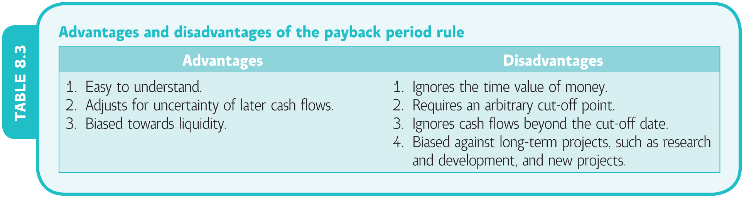
The Payback Rule

Slide 8

Time value of money concept
Q. If you had £2 million today, what might it be worth in 5 years time?
A. It depends what you could do with the £2 million (value creation):
Stash it in a bank vault (will still be worth £2 million in 5 years, less bank charges for storage)
Invest it in a safe place (earning 4% compound interest, 2 x 1.04⁵ = £2.43 million including interest)
Invest it in a risky business venture (may double in 5 years or be lost)
see Goetze p.47

Slide 9
Discounted cash-flow methods
The concept is the opposite of compound interest 1/(1+r)^{t}
We work back from future cash flow to the present value instead of adding interest going forward
What is a £ you expect to get in the future worth now? E.g. if interest is 10%, £1 received in a year’s time = 1/(1+0.1)¹ = 0.91
We use ‘discount tables’ to make the calculations easier
Estimate future cash inflows
Estimate the opportunity cost of capital using the time value of money concept. What is the rate of interest you either pay on borrowed funds or can earn on alternative investments?
Discount future cash flows back to their present value. Does the PV sum exceed the initial investment?

Slide 10
Activity brief
If you purchased a buy-to-let property in London for £2 million and rented it to a tenant who paid you rent, worth £100,000 a year after your annual landlord’s costs:
How long would it take to payback the initial outlay?
If you had to borrow the £2m at a mortgage rate of 8% what would the NPV be if you rented it out for 5 years? (you need to make an assumption about the property value at the end of 5 years) First assume you get your money back after costs of disposal, then assume 5% capital growth in the property market
What about a rental period of 8 years?
What if there was a rent review?

Slide 11
Activity solution – no capital growth
Payback would be 20 years at £100,000 pa to recover the £2m outlay (but of course you may have an asset worth more than £2m to sell in 20 years)
Discounted cash flow (£000s) | Cash flow | 8% Disc. factor | PV
Initial outlay (t = 0) | -2000 | 1 | -2000
Net cash inflows: t=1 | 100 | .93 | 93
t=2 | 100 | .86 | 86
t=3 | 100 | .79 | 79
t=4 | 100 | .74 | 74
t=5 | 100 | .68 | 68
Liquidation value at project end | 2000 | .68 | 1361
Σ Net present value (NPV) |  |  | -239

Slide 12
Activity solution – what if 5% capital growth
Payback would still be 20 years at £100,000 pa to recover the £2m outlay (but of course you do have an asset worth more than £2m to sell after renting)
Discounted cash flow (£000s) | Cash flow | 8% Disc. factor | PV
Initial outlay (t = 0) | -2000 | 1 | -2000
Net cash inflows: t=1 | 100 | .93 | 93
t=2 | 100 | .86 | 86
t=3 | 100 | .79 | 79
t=4 | 100 | .74 | 74
t=5 | 100 | .68 | 68
Sale value at project end = £2m x (1.05)⁵ = | 2553 | .68 | 1736
Σ Net present value (NPV) |  |  | +136

Slide 13
Appraisal techniques – NPV see Goetze p.50-60
Advantages
Accounts for the time value of money
Maximises shareholder value
Risk adjusted discount rate can be used
Issues
Difficult to compare different length projects
Need to ascertain an appropriate discount rate (cost of capital)
Ignores non-financial factors

Slide 14
Appraisal techniques – IRR see Goetze p.63-70
Advantages
Accounts for the time value of money (DCF)
Expressed as a % yield so easier to interpret and compare projects, even of different length
Do not have to identify a cost of capital as such
Can maximise shareholder value
Issues
May get confused with ROCE (a non-DCF %)
Need to ascertain a hurdle rate or target IRR to know if the project is worthwhile
Ignores non-financial factors
Ignores inter-relationship with other projects

Slide 15
Critique of DCF techniques
Only as good as the cash flow estimates input to the model, which are difficult to predict
Account for the time value of money but not for human behaviour in managerial judgement
Considered sophisticated but do not on their own lead to better corporate performance
Cannot be used for investment in projects with non-marketed outputs (non-financial benefits) so constrained to commercial sectors and projects

Slide 16

Information needed to appraise a takeover
Estimate of annual earnings:
Concept of free cash flow
What is a realistic timescale over which to appraise a takeover?
Estimate of the cost of capital (to use as a discount rate)
Find the present value of the future earnings stream (this is theoretically the maximum price you would offer)
What is the likelihood of synergies/economies of scale

